Slide 1




Comparison (WiFi Competitors)
 | BRCM 4325 | QCOM QCA4004 | TI CC3200 | Gainspan GS1011 | Rockchip RKi6000
 | 3.3V | 3.3V | 3.6V | 3.3V | 3.3V
Sensitivity@1Mbps | -94dBm | -95dBm | -95.7dBm | -92dBm | -94.7dBm
Rx Power | 90mA | 64mA | 59mA | 140mA | 20mA
The Best Choice
Lowest Power WiFi
Rockchip Confidential Proprietary

Slide 2
Comparison (Other Standard Competitors)
 | CSR WLCSP | TI CC2540 | TI CC2520 | Rockchip RKi6000
 | 3.15V | 3.0V | 3.0V | 3.3V
Standard | BT 2.1 +EDR | BT 4.0 (LE) | Zigbee | WiFi 802.11b
Max Data Rate | 3Mbps | 1Mbps | 250Kbps | 11Mbps
Receive Power
Sensitivity@1Mbps | N/A | -99dBm | -98dBm | -95dBm
Peak Rx Power | 45mA 141.75mW | 19.6mA 58.8mW | 18.5mA 55.5mW | 20mA 60mW
Rx Energy Efficiency | 47.25 nJ/bit | 58.8 nJ/bit | 222 nJ/bit | 6.0 nJ/bit
Transmit Power
Max Output Power | 6dBm | -6dBm | 0dBm | 0dBm
Peak Tx Power | 45mA 141.75mW | 24mA 72mW | 25.8mA 77.4mW | 20mA 60mW
Tx Energy Efficiency | 47.25 nJ/bit | 72 nJ/bit | 310 nJ/bit | 6.0 nJ/bit
Rockchip RKi6000
Low Power WiFi
Same as BT LE
Lower than BT

Slide 3
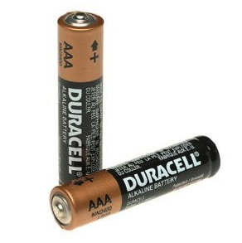
RKi6000 Energy Saving 85%
Receive Power ONLY @20mA
e.g. Run WiFi for IoT applications
Up to 35years on AAA battery
VS. Atmel up to 10Years
@30mins interval speed

